Slide 1
Asleep at the Wheel
Tips to keep you awake and alert behind the wheel
Delaware Office of Highway Safety
Corporate Outreach
Fall 2015
Notes:
Did you know that drowsy driving causes more than 100,000 crashes a year, resulting in more than 40,000 injuries and 1,550 deaths? As tragic as these numbers are, they only tell a portion of the story. It is widely recognized that drowsy driving is underreported as a factor in crashes.

Slide 2
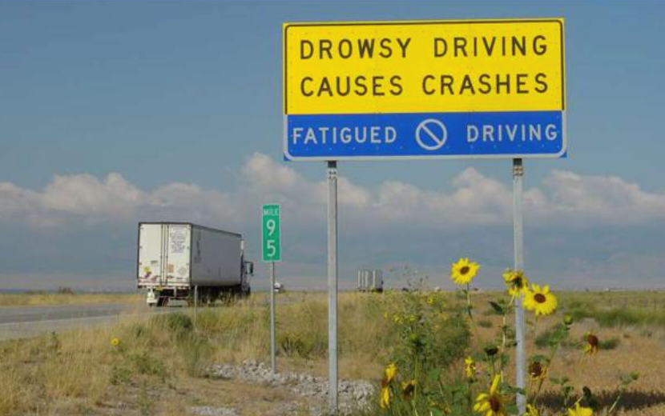
Utah Department of Public Safety
Notes:
Drowsy driving. Sleep-deprived driving. Fatigued driving. No matter what you call it, it’s dangerous. Open the discussion with examples of times that you (the presenter) have driven drowsy. Ask the audience for examples of times when they kept driving even after the point they should have stopped.

Slide 3
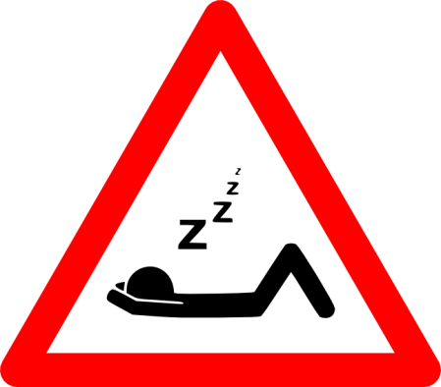
Signs of Drowsy Driving
The inability to recall the last few miles traveled.
Having disconnected or wandering thoughts.
Having difficulty focusing or keeping your eyes open.
Feeling as though your head is very heavy.
Drifting out of your driving lane, perhaps driving on the rumble strips.
Yawning repeatedly.
Accidentally tailgating other vehicles.
Missing traffic signs.
Notes:
What does drowsy driving feel like? Here are the signs. According to the AAA Foundation for Traffic Safety, 96% of all drivers feel that drowsy driving is acceptable behavior. How often do you feel this way behind the wheel? (ask for raised hands)

Slide 4
Who is most at-risk?
Young People : Sleep-related crashes are most common in young people, especially those who tend to stay up late, sleep too little, and drive at night.
Shift Workers and People with Long Work Hours : Shift workers and people who work long hours are at high risk of being involved in a sleep-related crash.
Commercial Drivers : Those who drive a high number of miles and drive at night are at significantly higher risk for fall-asleep crashes.
People with Undiagnosed or Untreated Sleep Disorders : Many different sleep disorders result in excessive daytime sleepiness, placing this group at high risk for sleep-related crashes.
Business Travelers : “Jet lag” as well as long work hours
put these weary travelers at increased risk for
sleep-related crashes.
Notes:
According to the AAA Foundation’s research, certain groups of people more inclined to drive drowsy. Does your audience fall into any of these categories? In your experience, discuss how getting a good night’s sleep is difficult at times.

Slide 5
“Sleepiness causes auto crashes because it impairs performance and can ultimately lead to the inability to resist falling asleep at the wheel. Critical aspects of driving impairment associated with sleepiness are reaction time, vigilance, attention, and information processing.”
- NCSDR/ NHTSA Expert Panel on Driver Fatigue and Sleepiness
Notes:
Quote from the National Highway Traffic Safety Administration (NHTSA) and the National Center on Sleep Disorders Research (NCSDR) expert panel on Drowsy Driving and Automobile crashes. http://www.nhtsa.gov/people/injury/drowsy_driving1/drowsy.html#NCSDR/NHTSA

Slide 6
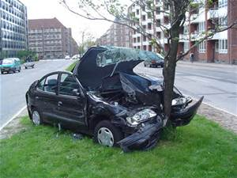
Crash characteristics:
Occurs during late night/ early morning or midafternoon.
The crash is likely to be serious.
A single vehicle leaves the roadway.
The crash occurs on a high-speed road.
The driver does not attempt to avoid a crash.
The driver is alone in the vehicle.
Notes:
Source: NHTSA. Typical characteristics of a drowsy driving crash.

Slide 7
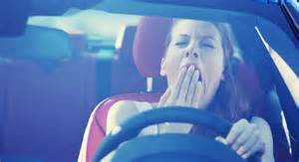
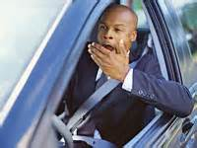
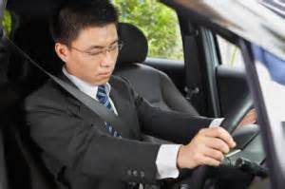
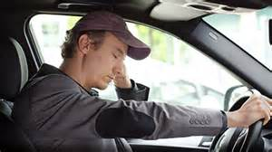
Notes:
What we can do to prevent drowsy driving? Just looking at these pics may make your audience yawn. Is anyone sleeping during this presentation? Discuss some common ways to stay awake: window down, coffee, music, etc.

Slide 8
“Sleeping is the most effective way to reduce sleepiness.”
- NCSDR/ NHTSA Expert Panel on Driver Fatigue and Sleepiness
Notes:
Common sense? For most, sleeping is the most effective way to reduce sleepiness.

Slide 9
Stay Alert
Get plenty of sleep (at least 7 hours) the night before a trip.
Stop driving if you become sleepy.
Travel at times when you are normally awake, and stay overnight if you’re driving a long distance.
Schedule a break every 2 hours or 100 miles.
Drink a caffeinated beverage, and find a safe place to take a 20- 30 minute nap while you wait for the caffeine to take effect.
Travel with an awake passenger.
Notes:
Tips from the AAA Foundation for staying alert on a long trip.

Slide 10
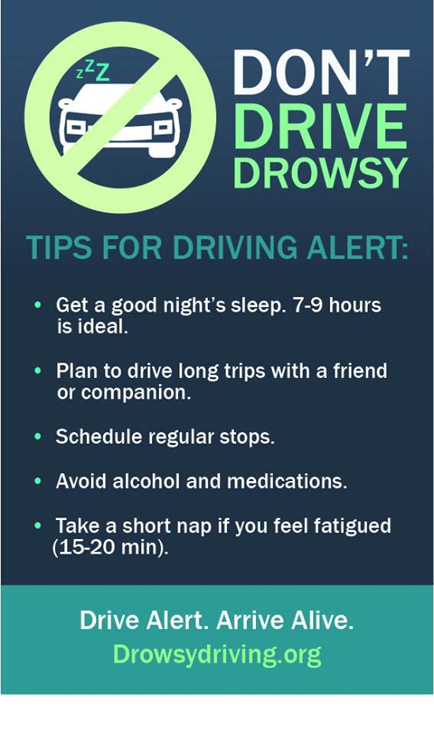
Notes:
Infographic from The National Sleep Foundation, www.Drowsydriving.org.

Slide 11
Workplace Policy
Notes:
This slide is for your workplace policy on fatigued driving. If you have drivers that fall under Federal Motor Carrier Safety Administration regulations, please place that information here. If neither applies, remove the slide.

Slide 12
Resources
AAA Foundation for Traffic Safety www.aaafoundation.org
The Sleep Foundation www.sleepfoundation.org
www.drowsydriving.org
National Highway Traffic www.nhtsa.gov
Safety Administration
Delaware Office of Highway Safety www.ohs.delaware.gov
Notes:
All of the information in this presentation came from these resources.

Slide 13
Thank you!
Delaware Office of Highway Safety
www.ohs.delaware.gov
302-744-2740
@DEhighwaysafe
Notes:
Encourage your audience to drive safe at all times, and to follow us on Twitter @Dehighwaysafe. Thank you!

